Slide 1
Saanich Transportation Advisory Committee
November 23, 2023

Slide 2
Agenda
Victoria Regional Transit System Overview
System & Saanich-Specific Performance
Victoria Regional Transit System Strategic Plans
Overview of upcoming transit planning processes
Corporate Initiatives
Umo
Low Carbon Fleet Program
NextRide

Slide 3
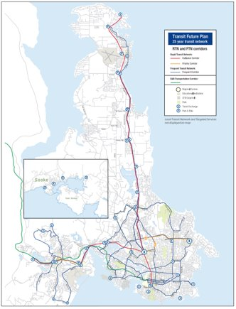
Victoria Regional Transit System Overview
Conventional Transit
Fixed routes and schedules
57 transit routes
22.4 million boardings in 2022/23
Range of vehicles, services:
Double Deckers
30’ 35’ 40’ vehicles
Community shuttles
Custom Transit (handyDART)
Door to door, demand responsive
Eligible people with a disability
Operated by First Canada ULC
Supported by taxi programs

Slide 4
System Overview
Notes:
Ridership recovery at 93% as of November 2023

Slide 5
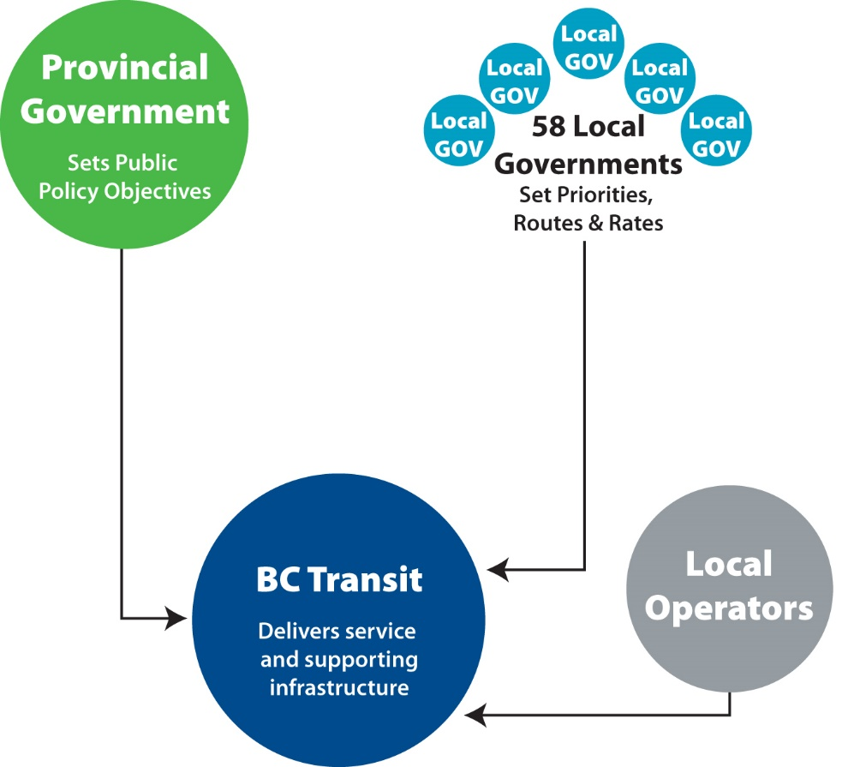
System Operates Through Partnership: BC Transit’s Model
Victoria Regional Transit Commission
Plans community, establishes transit priorities and routes
Sets service levels and approves budgets
Set fares
Provide local tax subsidy
BC Transit
Turns VRTC priorities into transit operating and capital plans
Works with Province to access funding
Operates Victoria conventional service
Custom Transit operated via contracted service provider
Manages capital program

Slide 6
Background: Victoria Regional Transit Commission
Established under the British Columbia Transit Act
Local government representation for transit services in the CRD
Eight elected local government officials are appointed by the Province
Chair is designated by the Minister responsible for BC Transit
Appointment process, composition and term described in the Act
Staff, resources and contracted services provided by BC Transit

Slide 7
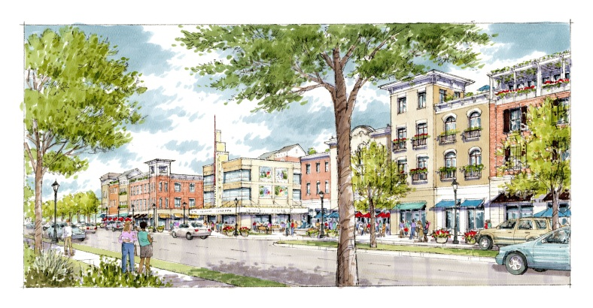
Local Government Collaboration
Bus stops and shelters
Collaboration on infrastructure for multi modal transportation (municipalities responsible for roads)
Local planning initiatives (OCP etc.)
Development Referrals
Stakeholder engagement
Collaboration with MOTI on Highways infrastructure
Collaboration with CRD on regional growth strategies, regional parks and trails

Slide 8
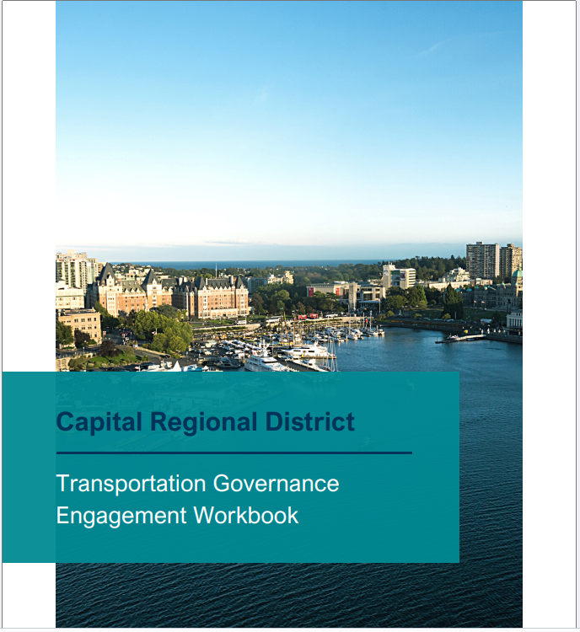
CRD Transportation Governance Engagement
Engagement workbook submitted on behalf of Victoria Regional Transit Commission
BC Transit and the VRTC will continue to work with CRD on next steps

Slide 9
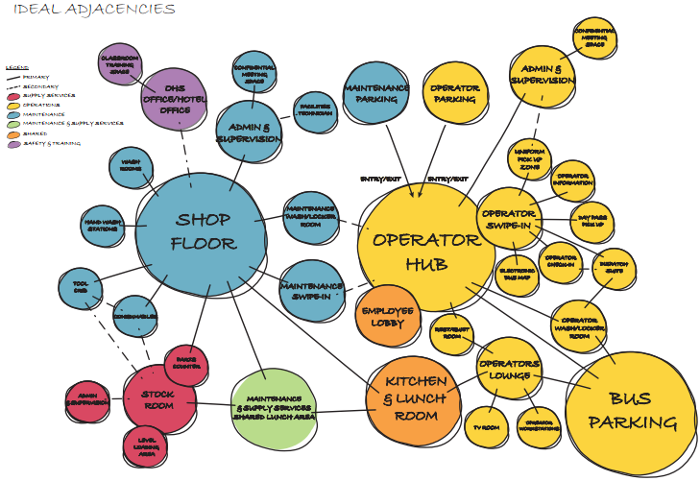
VRTS Facility Master Plan
In June 2022 the Commission endorsed the VRTS Facility Master Plan, including:
A strategic roadmap for future transit facility investment options that support a transition to battery electric buses and a future transit fleet of up to 600 conventional buses and 110 handyDART buses
View Royal handydart – “Early Works” phase substantially complete; final phase of building construction underway; On-going First Nations engagement
Victoria and Langford Facility Upgrades – Pre-implementation is underway, includes 10 battery electric bus deployment and supports expansion
Saanich Transit Centre Phase 1 – Awaiting funding approval; Planning work underway; Early outreach underway with First Nations groups
8

Slide 10
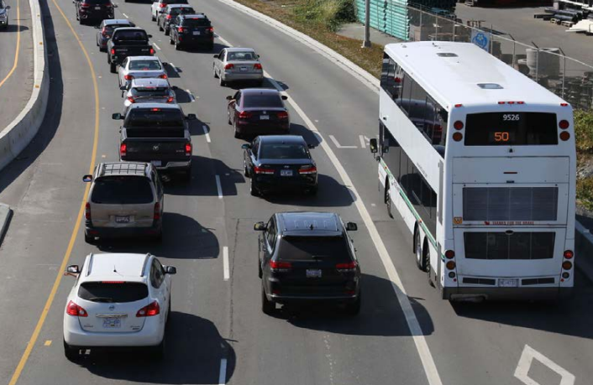
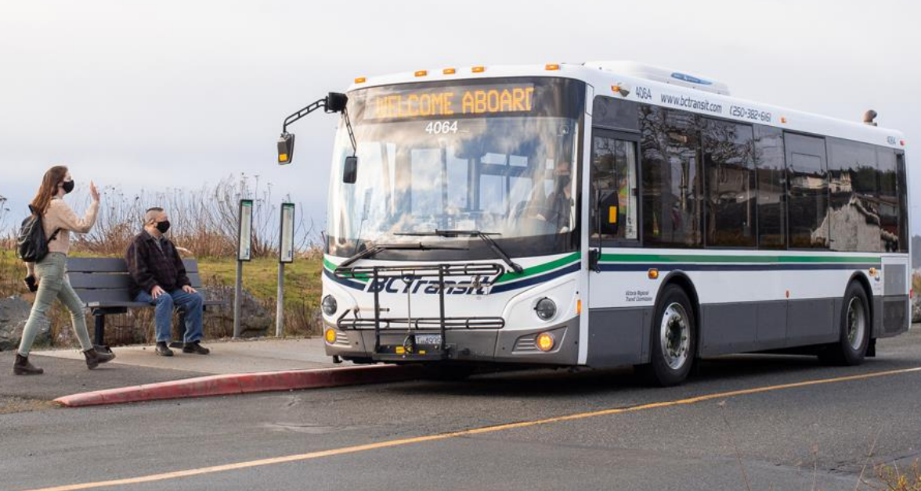
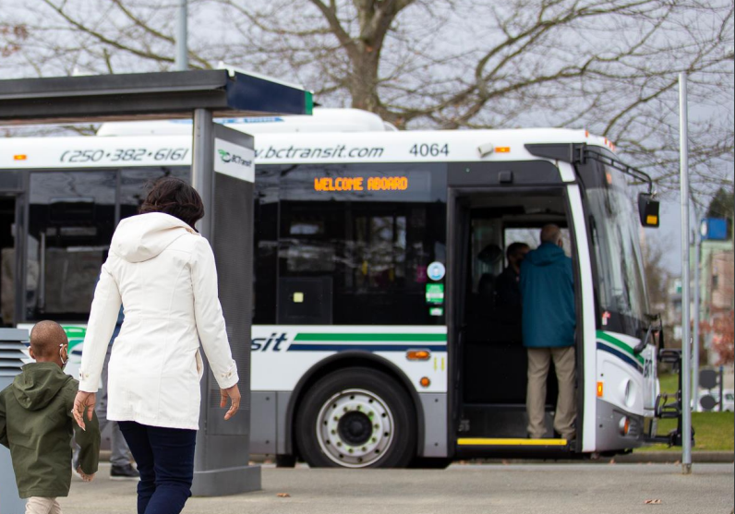
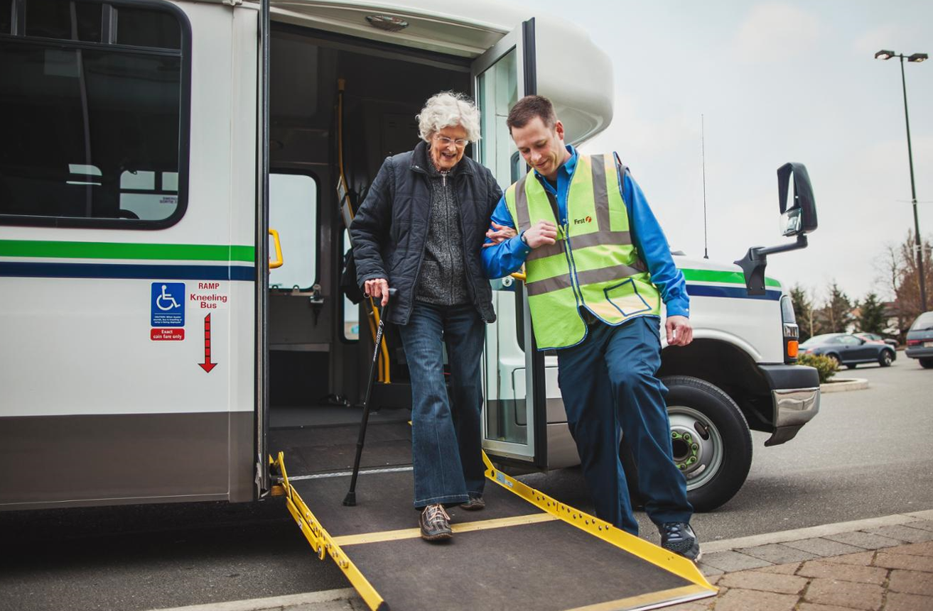
System Overview
Rapid Transit Network
Frequent Transit Network
Local Transit Network
Targeted Services

Slide 11
Transit System in Saanich
Notes:
Has some of the highest frequency, highest ridership routes operating through Saanich, including Routes 4, 6, 14, 26, 27/28, and 95.
As of the Fall 2023 service period, Saanich is seeing an average of ~29,500 weekday boardings, which accounts for approximately 35% of total system weekday boardings.

Slide 12
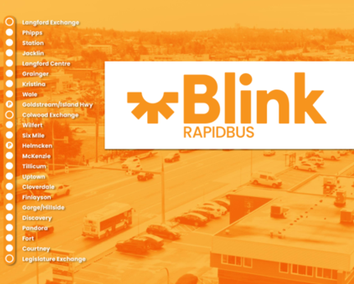
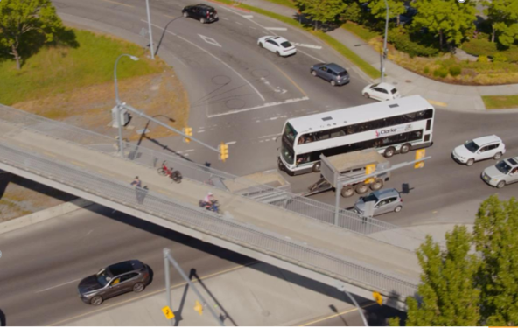
RapidBus
CONNECTED, FREQUENT, FAST AND RELIABLE
RapidBus is a bus delivered rapid transit service designed to connect and support designated urban centres of high density, mixed-use areas of the region
Features include branded services, corridor treatments, unique stations, limited stops and high frequencies

Slide 13
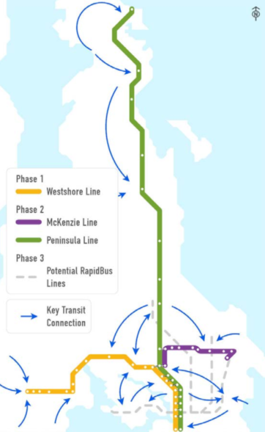
RapidBus Implementation Strategy
Endorsed by the Victoria Regional Transit Commission in 2021. The RapidBus Implementation Strategy identifies three top priority RapidBus lines separated into two phases:
West Shore RapidBus Line (Phase 1)
Island Highway Transit Priority Improvements
RapidBus Station Study
Downtown Victoria Visioning
McKenzie RapidBus Line (Phase 2)
Corridor Study
Peninsula RapidBus Line (Phase 2)
RapidBus stations
Transit hub study (Sidney)

Slide 14
Transit Planning Overview

Slide 15
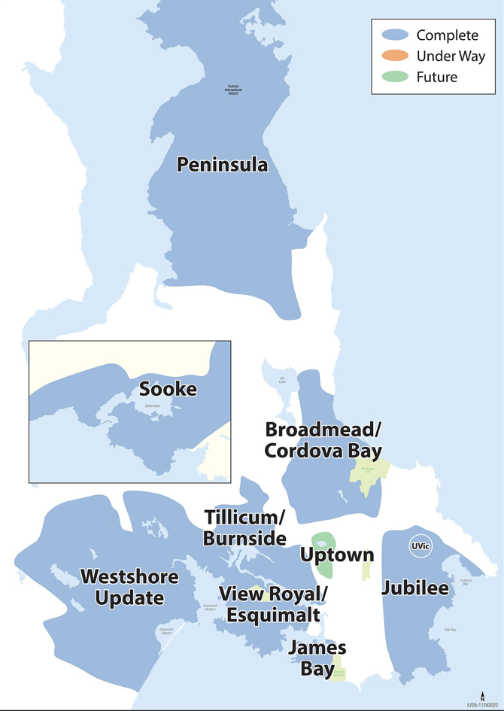
Local Area Transit Plans
Local Area Transit Plans build upon the vision developed in the Victoria Region Transit Future Plan and the Victoria Regional Transit System 2013/14 Service Review.
10 LATPs completed
Support community development by building upon the direction established within a community’s Official Community Plan and relevant municipal transportation & land use plans

Slide 16
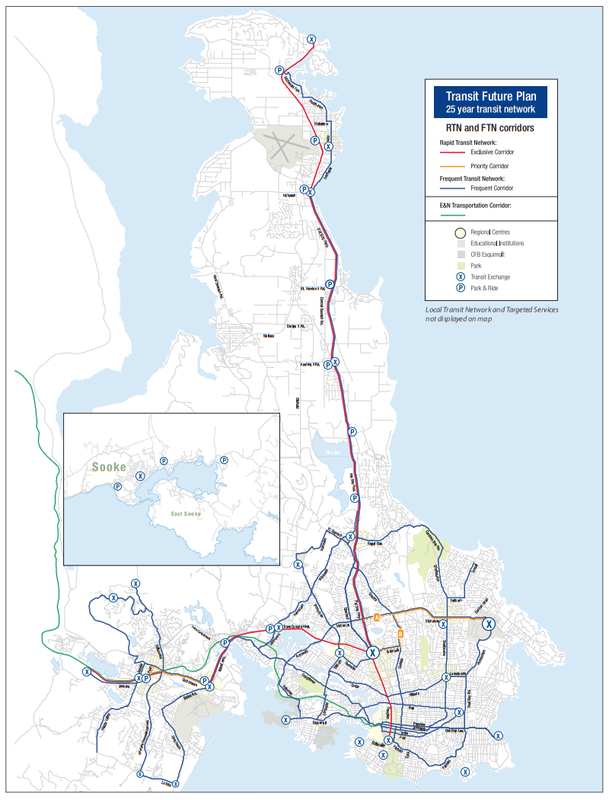
Regional Corridor Strategy
Replace the 2011 Transit Future Plan and update the Transit Future Network, with an intention to update the document biennially.
Develop a regional corridor strategy and supporting work plan to prioritize and:
Update the regional and local transit networks to align with the future Uptown Mobility Hub development,
Update the network to support cross-town network development,
Support service and infrastructure planning for future RapidBus corridors, and
Support land use and transit integration by aligning with upcoming Local Government Partner corridor planning processes.

Slide 17
Regional Corridor Strategy
The resulting prioritized work plan will include a phased list of Corridor Plans and Local Area Transit Plans needed to support the goals of the Regional Corridor Strategy
The top 3 priority corridor transit plans emerging from the Regional Corridor Strategy all have implications for future transit in Saanich:
Quadra Street
Tillicum Road/McKenzie Avenue
Hillside Avenue

Slide 18
Future Service Expansion
Approved by the VRTC in 2023/24:
2024/25: 20,000 hours, 8 buses
2025/26: 30,000 hours, 12 buses
2026/27: 40,000 hours, 16 buses
Subject to Provincial funding (confirmed annually on Budget Day)
Key strategic service investments priorities:
RapidBus and Frequent Transit Network service improvements
Development of the crosstown network on the Hillside/Gorge and Admirals/McKenzie corridors
Simplifying and improving transit service on the Quadra corridor
Improvements to YYJ Airport and Peninsula service

Slide 19
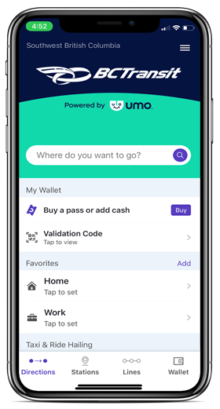
Electronic Fare Collection System (Umo)
BC Transit’s new fare collection technology
Replacing end-of-life and costly fare technology
Better meets the expectations of riders
Reduces barriers to fare payment and transit access
Primary customer-facing components:
Mobile app
Reloadable fare card
Onboard fare validator
Dedicated customer call centre
Future ability to enable onboard credit and debit card tap payments
Increased and improved data to inform recommendations
Now launched in the Victoria Regional Transit System!
18
Notes:
We continue to see growing adoption rates and positive feedback from riders pleased with the benefits Umo’s arrival has brought them.
Data shows that there are over 14k active Umo riders per day.
Data shows that we reached one million boardings with a Umo payment method in October.
Through September and October, the project ran a digital marketing campaign to support rider adoption and education.
Last month, the project hosted a series of engagement events to capture transit operator’s feedback on Umo’s introduction and early use. The engagement events were very well attended and captured considerable feedback showing that transit operators are pleased with Umo’s arrival and see it as an improvement. The project is working with Operations to address questions and improve onboard performance and rider adoption.
In the coming weeks, the project plans to progress with regional transit system deployments, starting with the Cowichan Regional and Regional District of Nanaimo transit systems. This will provide riders in the VRTS the ability to seamlessly travel to the Cowichan Valley and Central Island with one payment method and fare product.
In the VRTS, the project’s attention will focus on supporting riders who have yet to make the transition to a Umo payment method before the old fare system is turned off.

Slide 20
Low Carbon Fleet Program

Slide 21
Victoria Regional Transit System Deployment
Battery Electric Demonstration (BEB) bus now in service
10 BEBs coming to the VRTS
New electric bus and charging infrastructure projects in development
Joint funding announced in July 2023 for $395.5 million for up to 115 BEBs and 134 charging points

Slide 22
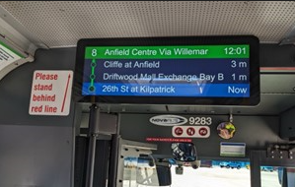
NextRide
Allows riders to see the real-time location of their bus and its predicted arrival time at an identified stop
NextRide data assists with schedule reliability, managing on-road incidents more effectively and customer communications
NextRide refresh starting in January
help provide increased certainty, convenience and predictability for transit customers
new digital full-colour passenger information displays inside all heavy-duty buses & high-capacity buses
Notes:
The NextRide Technology Refresh project is funded through the Investing in Canada Infrastructure Program. This project is being cost shared with the Government of Canada contributing 50 per cent, the Province of British Columbia contributing 40 per cent and local government partners contributing the remaining 10 per cent. The cost for the entire project is $16.8 million.

Slide 23
Questions?
Chelsea Mossey
Senior Manager, Government Relations
CMossey@bctransit.com
Levi Megenbir
Senior Transit Planner/Work Lead
LMegenbir@bctransit.com

